Slide 1


Emergency Department Medication Reconciliation
Pilot Study
Hina Patel, PharmD
hpatel19@partners.org
Jeff Schnipper, MD, MPH
Kate Ulbricht, PharmD, MBA

Slide 2
Setting and Subjects
Brigham and Women’s Hospital Emergency Department is a level-1 trauma center with >23,500 patients admitted from ED to inpatient beds per year
Concerned about medication conversion during PeCare new electronic health record (EHR) launch phase so launched pilot program to improve patient safety and prevent ADEs
Best Possible Med Histories (BPMH) of ED patients designated for admission or in EDOBS from 8am-12 midnight
>18 years old, regardless of the number of past visits at a Partners-affiliated institution
No written patient consent needed, internal quality improvement initiative

Slide 3
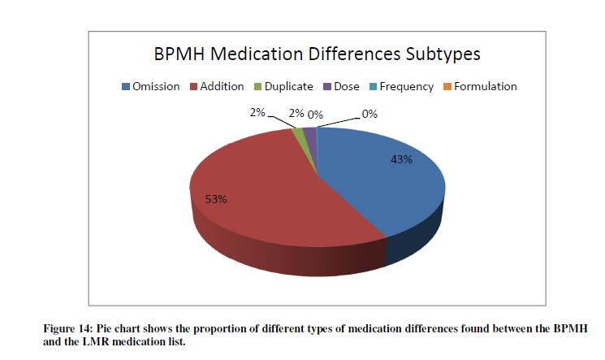
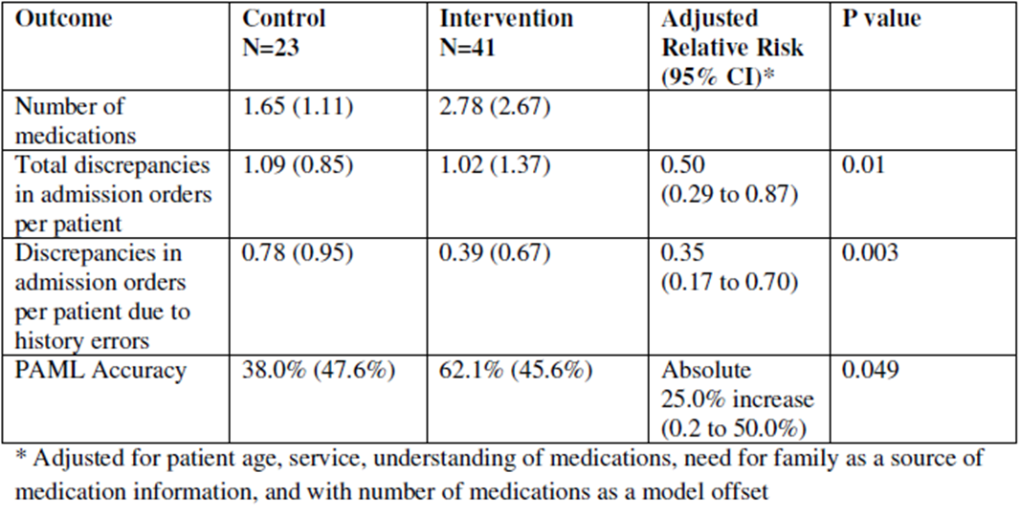
Outcomes
65% Reduction in medication Errors
ED Med Rec Support Team modified ~7.07±0.58 features on each patient’s pre-admission medication list compared with legacy ambulatory LMR

Slide 4
Efficiency and ROI Summary
Work force efficiency ~1.21 patients/hr for all med history takers
Average significantly decreased by rotating pharmacy students on 6-week clerkships
5 year aggregate ROI ~$726k to $1.12M (higher with rotating pharmacy students)
Assumes all eventually efficient enough to see 1.7 patients/hr, students may not hit max efficiency but add benefits (help more patients, stipends, validate training materials, conduct audits, mentorship value, recruiting tool)
We conclude that this med rec initiative improves patient safety by decreasing med discrepancies, and has short and long-term financial benefits

Slide 5
Other Potential Intervention Benefits
Reduce readmission and litigation expenses for the hospital due to ADEs
Providers and nurses can serve more patients
Improve staff satisfaction with workflow efficiency, aiding recruitment and retention
Increase satisfaction with EHR transition
Gain multidisciplinary trust in clinical pharmacists, making future targeted pharmacist-led drug cost reduction efforts more easily achievable
Support regulatory compliance (NPSGs)
Public relations benefits for the hospital

Slide 6
Limitations
ROI calculation
  0.9% of med errors that lead to actual harm based on Bates study from the 1990s, before we knew what med rec was (i.e., this is for all types of medication errors)
  Percentage is probably a low estimate, but for med rec errors specifically, we don't know what percent lead to actual inpatient harm
Pharmacy students doing 6-week rotations
  Standardization of data collection was more challenging, re-training time investment

Slide 7
Additional Challenges
ED open 24/7, so only saw ~74% of patients admitted from ED
Sicker patients in the ED on more meds, difficult to interview
Only 16% patients had med lists available during ED visits
  Time spent during interview could have been much less if patients had up-to-date med lists

Slide 8
Proposed Future Improvements
1. Staff workflow improvements
  Utilize electronic scheduling
  2. Utilize algorithm
  Prioritize patients by automatically stratifying them into risk categories
3. Better inform inpatient clinical staff about the program
4. Offer counseling
  Improve patient outcomes for high-risk conditions, populations, or medications
  Remind patients to keep current med list with them
Notes:
Scheduling could make sure that staff doesn’t waste their time trying to see a patient who’s not in a position to be seen
Informing clinical staff on the wards is important to make sure they read the notes written by med rec support staff and take necessary next steps

Slide 9
Implications for Hospital
Leadership
Site success & failure (nationally and at BWH) was directly related to institutional support
Successful efforts had an executive sponsor from the “C Suite”
Administrative support at the hospital level is needed
Effort will likely require support on several fronts
Good Med Rec = Culture Change
Med Rec processes are interprofessional.
Allows for:
  Understanding of baseline practices & variations
  Creating clear delineation of roles & responsibilities
Med Rec processes are interprofessional.
  An engaged interprofessional QI team
Allows for:
  Understanding of baseline practices & variations
  Creating clear delineation of roles & responsibilities
Notes:
Successful efforts had an executive sponsor from the “C Suite” who saw at least some of the following:
Financial ROI = $$ savings to spend on resources
Links to other initiatives
Readmissions, transitions of care, medication safety
Sentinel events from their own institutions
Baseline data on discrepancy rates
Administrative support at the hospital level is required for:
Clinician training (BPMH, discharge med rec and counseling)
QI project management
Resources for ongoing data collection & focused intervention data
“Measure-vention” improves outcomes!
Effort will likely require support on several fronts
Management of political issues
Support for process redesign, clarification of roles and responsibilities, reducing redundancy, moving work to earlier in the process
Likely need for additional/different clinical resources
Some work required that has never been adequately resourced
Ongoing training & competency assessment
Med Rec processes are interprofessional. Best improvement seen with:
Clinical champion(s)
Especially across disciplines involved with history taking, order writing & patient education
Pharmacy and/or nursing support, IT
Key stakeholders
An engaged interprofessional QI team

Slide 10
Next Steps
Strategies for sustainability
  Second round of mentored implementation funded by AHRQ: now recruiting 18 new sites
  Disseminate the MRA model broadly
    Train the trainer workshop just completed at ASHP Leaders Conference
  Develop a BPMH curriculum for medical students, using didactic materials, videos, simulation testing from MARQUIS
    Macy Foundation proposal submitted
  National roundtable discussions
    NQF Measure
    Balanced Scorecard
    EHR Vendors
Notes:
Site 2
The QI team at this 535-bed community non-teaching hospital associated with a large regional healthcare system is led by the Vice President for Clinical Improvement, with other members of the team including hospitalists, clinical pharmacists, nurses, and the on-site study pharmacist. Their initial intervention targets included training in taking a BPMH and good discharge medication education as well as giving feedback to providers on the quality of their medication histories.
To date, progress has been made in 4 areas:
BPMH training: BPMH training video and pocket cards are used by nursing and pharmacy staff on target units to perform medication histories for patients who are directly admitted, transferred from other hospitals, or admitted on weekend nights. This complements a pre-existing initiative that utilizes pharmacy technicians, called Medication Reconciliation Assistants (MRAs), to take medication histories for all ED patients admitted during the week and weekend days.
Risk stratification: Development of an automated screening tool to identify high-risk patients and having clinical pharmacists attend daily discharge rounds to determine which patients require high-intensity discharge education.
High-intensity bundle in high-risk patients: Plans are in place to formally train a cohort of clinical pharmacists and discharging providers to provide high-intensity discharge education for high-risk patients .
Discharge education: The discharge education training video was placed on the organization’s intranet to complement existing education modules on “teach back” and “Ask Me 3,” a patient education program designed to promote communication between patients and clinicians.³⁵ Clinical pharmacists can now flag high-risk patients for intensive discharge counseling in their workflow database and see which high-risk patients have received in-hospital intensive counseling and which have not. This complements an existing program which provides post-discharge counseling by phone for a subset of patients (e.g., older patients with a PCP within a particular provider group, discharged home, referred to the program, or on multiple or high-risk medications) run by the regional healthcare system.
Key factors promoting success include the dedication of the QI team leader and on-site study pharmacist, full support from the leadership of the regional healthcare system, and integration of the intervention components with previously adopted site initiatives, such as the use of MRAs and the post-discharge education program for high-risk patients. Barriers have included a smaller QI team to lead intervention efforts, difficulty in engaging front-line staff, limited availability of MRAs on weekend nights and for patients not admitted through the ED (and over-reliance on MRAs even for patients in whom they are not available), lack of access to administrative data to help guide next steps, and lack of educators trained in the use of teach back.
As with Site 1, several lessons have been learned. Progress at Site 2 has been somewhat slower with less engagement from front line providers and a smaller QI team. Across both sites, our experience confirmed the important QI principle that education itself is not sufficient to change behavior to achieve best practice; certification of competency is required. A need for site-specific data to help make the case to front-line providers is also essential for ongoing engagement with the improvement effort, and is now a goal of the central data analysis team. For example, Site 2 needed to know medication discrepancy rates among patients not affected by MRAs (e.g., weekend night admissions, direct admissions) compared with other patients.
How does this relate to what is mentioned above for risk stratification? Are different people being trained to replace the pharmacists doing it now?
Jeff Schnipper: John and Jason, can you answer this question?
Jason: it’s a human resource allocation relationship, extending the responsibility to hospitalists rather than replacing pharmacists; specifically for the high risk patients not qualifying to receive discharge counseling from the existing post-discharge program (SafeMed) the work would have to be allocated across the clinical pharmacists and discharging hospitalists (both of which would be learners in a formal training program)

Slide 11
Acknowledgment
Brian Alesandro, PharmD
Catherine Behret
Joseph Bizier
James Brewster
Vanya Chan
Heather Cocchi
Casey Dempsey
Cameron Dumas
Martin Hesselbacher
Vivian Hua
Shanice Johnson, CPhT
Eunji Michelle Ko, PharmD
Xiao Liang
Dylan Moriarty
Sikemi Obatusin
Hina Patel, PharmD
Nikhil Sangave
Daisy Sarpong
Pauline Situ
Edmond Solomon
Christopher Talbot
Amanda Tang, PharmD
Mark Thistlewood, CPhT
Jonathan Tiongson
Rohit Tonk, MD
Shira Winter, RN
Notes:
Scheduling could make sure that staff doesn’t waste their time trying to see a patient who’s not in a position to be seen
Informing clinical staff on the wards is important to make sure they read the notes written by med rec support staff and take necessary next steps

